Slide 1

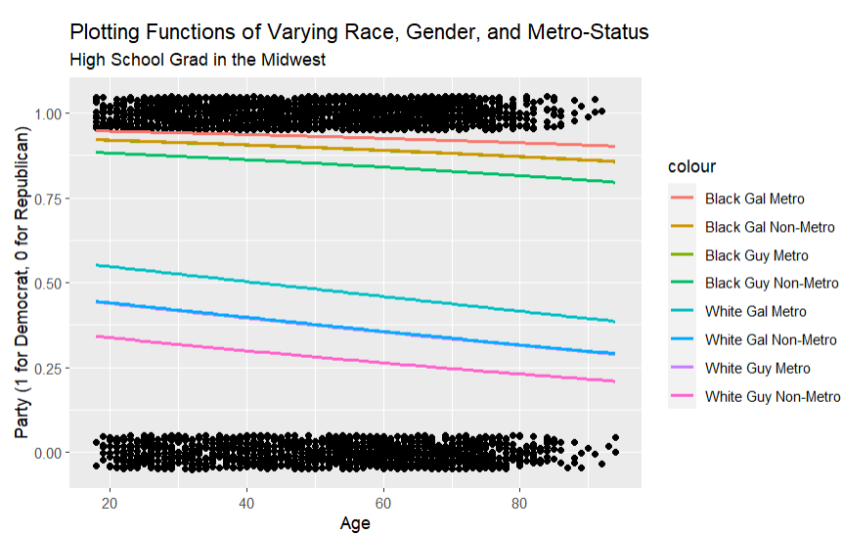
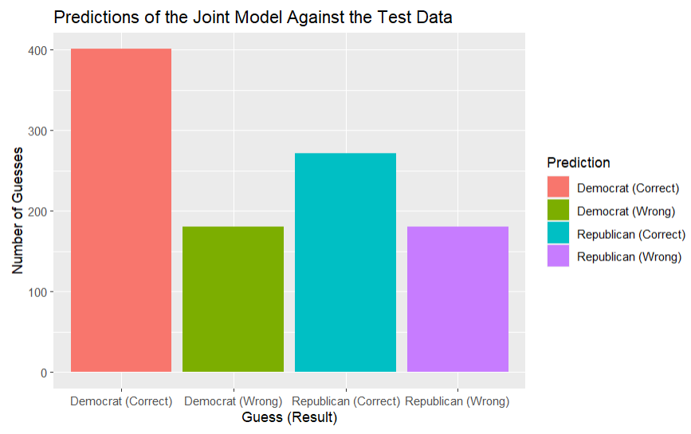
Predicting Political Affiliation of Adults in the United States Aaron Oakes and Nicholas Sutton
Introduction
Results
Discussion
Unlike a lot of other countries, the United States only has two major political parties: Republican and Democrat. Most elections come down to these parties. Oftentimes, people like to make generalizations about those who vote for certain parties. This information is not useful when the generalizations come down to anecdotes, but it can help predict election outcomes when done objectively with a large sample size. We are interested in finding out what factors most influence party alignment in the United States.
 | Age | Education | Race | Gender | Metro Status | Region | Joint
AIC | 4677 | 4699.2 | 4320.3 | 4691.5 | 4672.9 | 4698.8 | 4195.8
Upon comparing the AIC of all the models, we see that out of the individual models, the Race model is the lowest. This suggests that Race has a larger impact on political alignment than the other variables.
The Joint model with all the variables as predictors has the lowest AIC, so each predictor more than makes up for the increase it causes in AIC.
In the scatterplot of our joint model, we see the impact that age, gender, metro status, and race have on the probability of someone leaning left or right. Race makes a very large difference, with black men and women being much more likely to lean left than white men and women. Metro Status and Gender have a nearly equal effect within each race, to the point where Metro men and non-Metro women overlap for both the white and black curves.
When tested with new data, the training model was able to correctly guess political party affiliation 65.6% of the time. This shows that the model can accurately predict party affiliation based on these variables. 65.6% is kind of low, which tells us that there are more nuances to which political party someone aligns with than just these predictors.
Objectives
Our objective is to determine any trends in political affiliation for the United States in January of 2020 based on 6 factors: Age, Education, Race, Gender, Metro Status, and Region.
Study Design
Our predictor variables are age, years of education, race, gender, metro status, and region. Age is numeric, and the other variables are categorical.
Education is split into less than high school, high school, some college, and bachelor’s degree or higher
Race is split into White, Black, Hispanic, and 2+ races
Region is split into Northeast, South, Midwest, and West
These where all used to predict our response variable, “Leaned Party Identification.” This is a categorical variable with 2 values: “Lean Right,” and “Lean Left” that were reassigned as 0 and 1, respectively.
Logistic Regression was used to create a model with all these variables as predictors. Following this, a training model was trained on 70% of the data and used to predict the remaining 30%.
References
Pew Research Center. (2021, May 14). 2020 census survey #1 archives. Pew Research Center’s Social & Demographic Trends Project. Retrieved April 11, 2023.
Acknowledgments
Thank you to Dr. Tanner for teaching us things. Thank you to the average American for being predictable.

